Slide 1
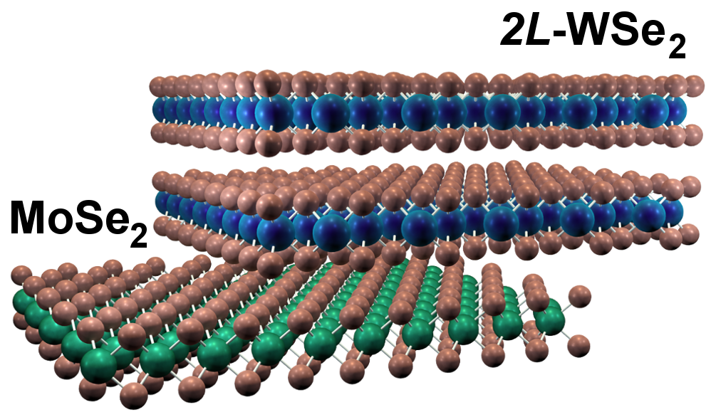
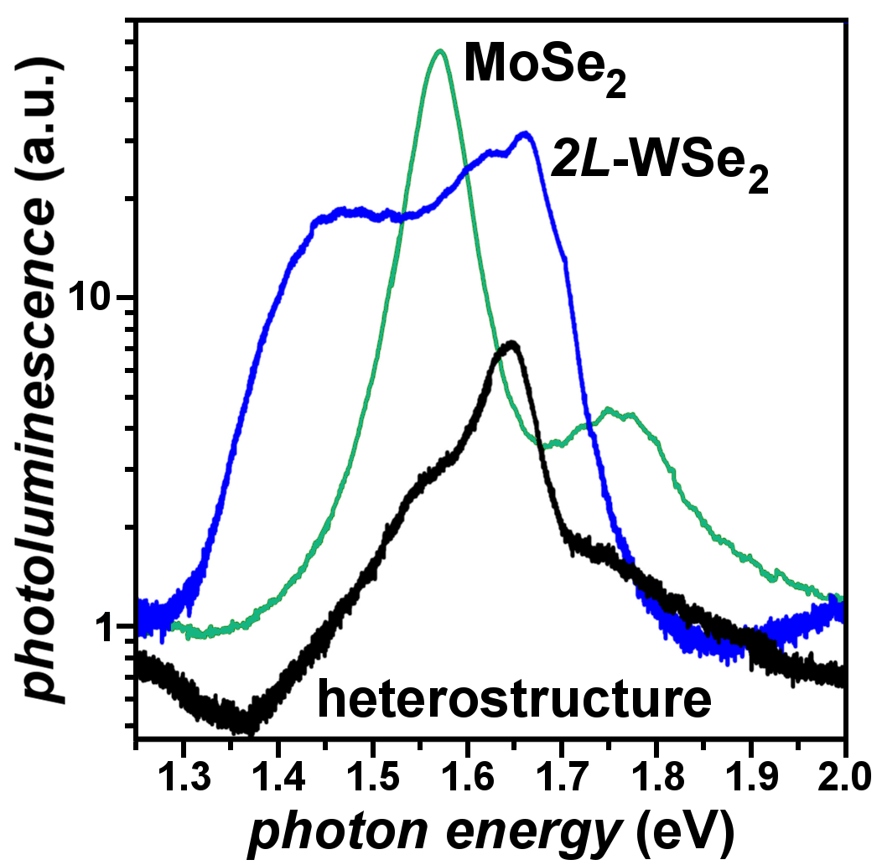
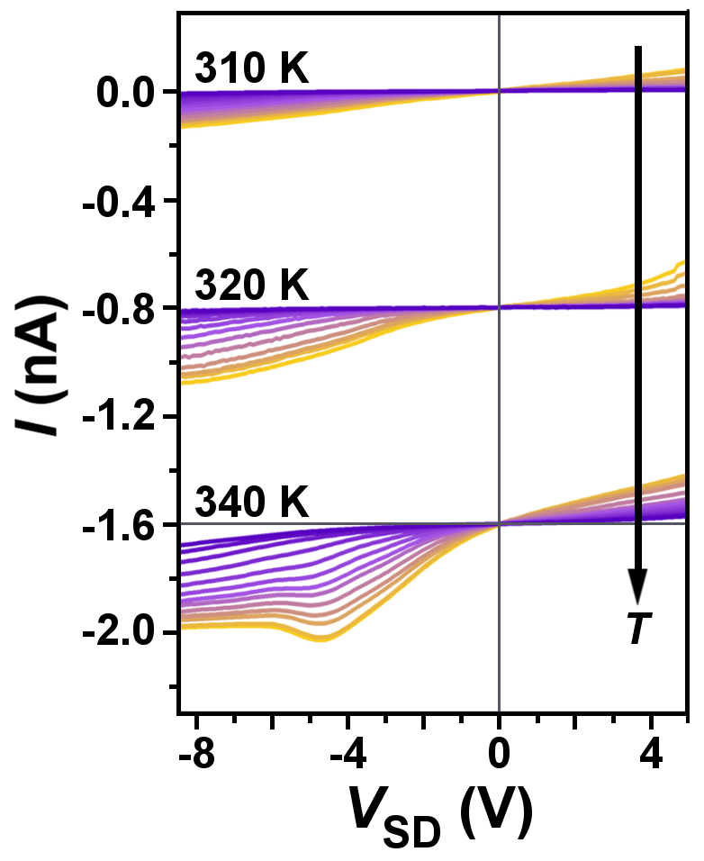
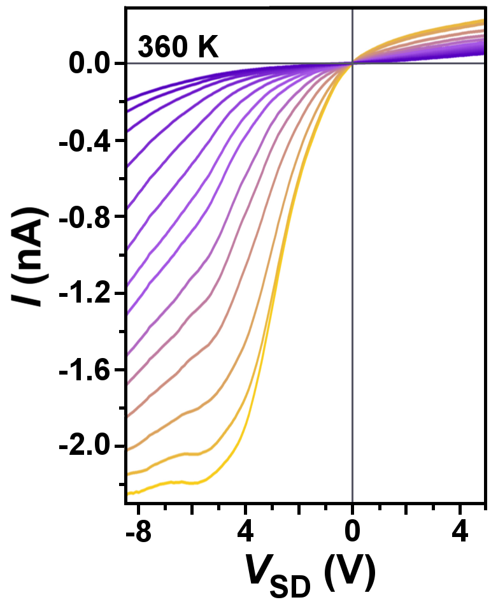
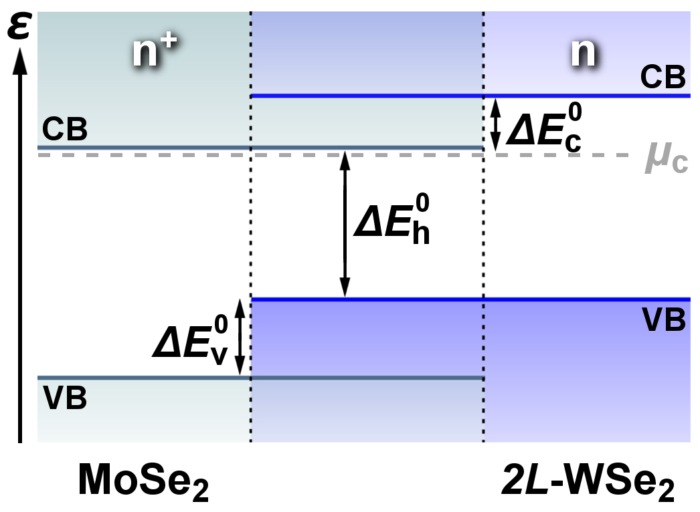
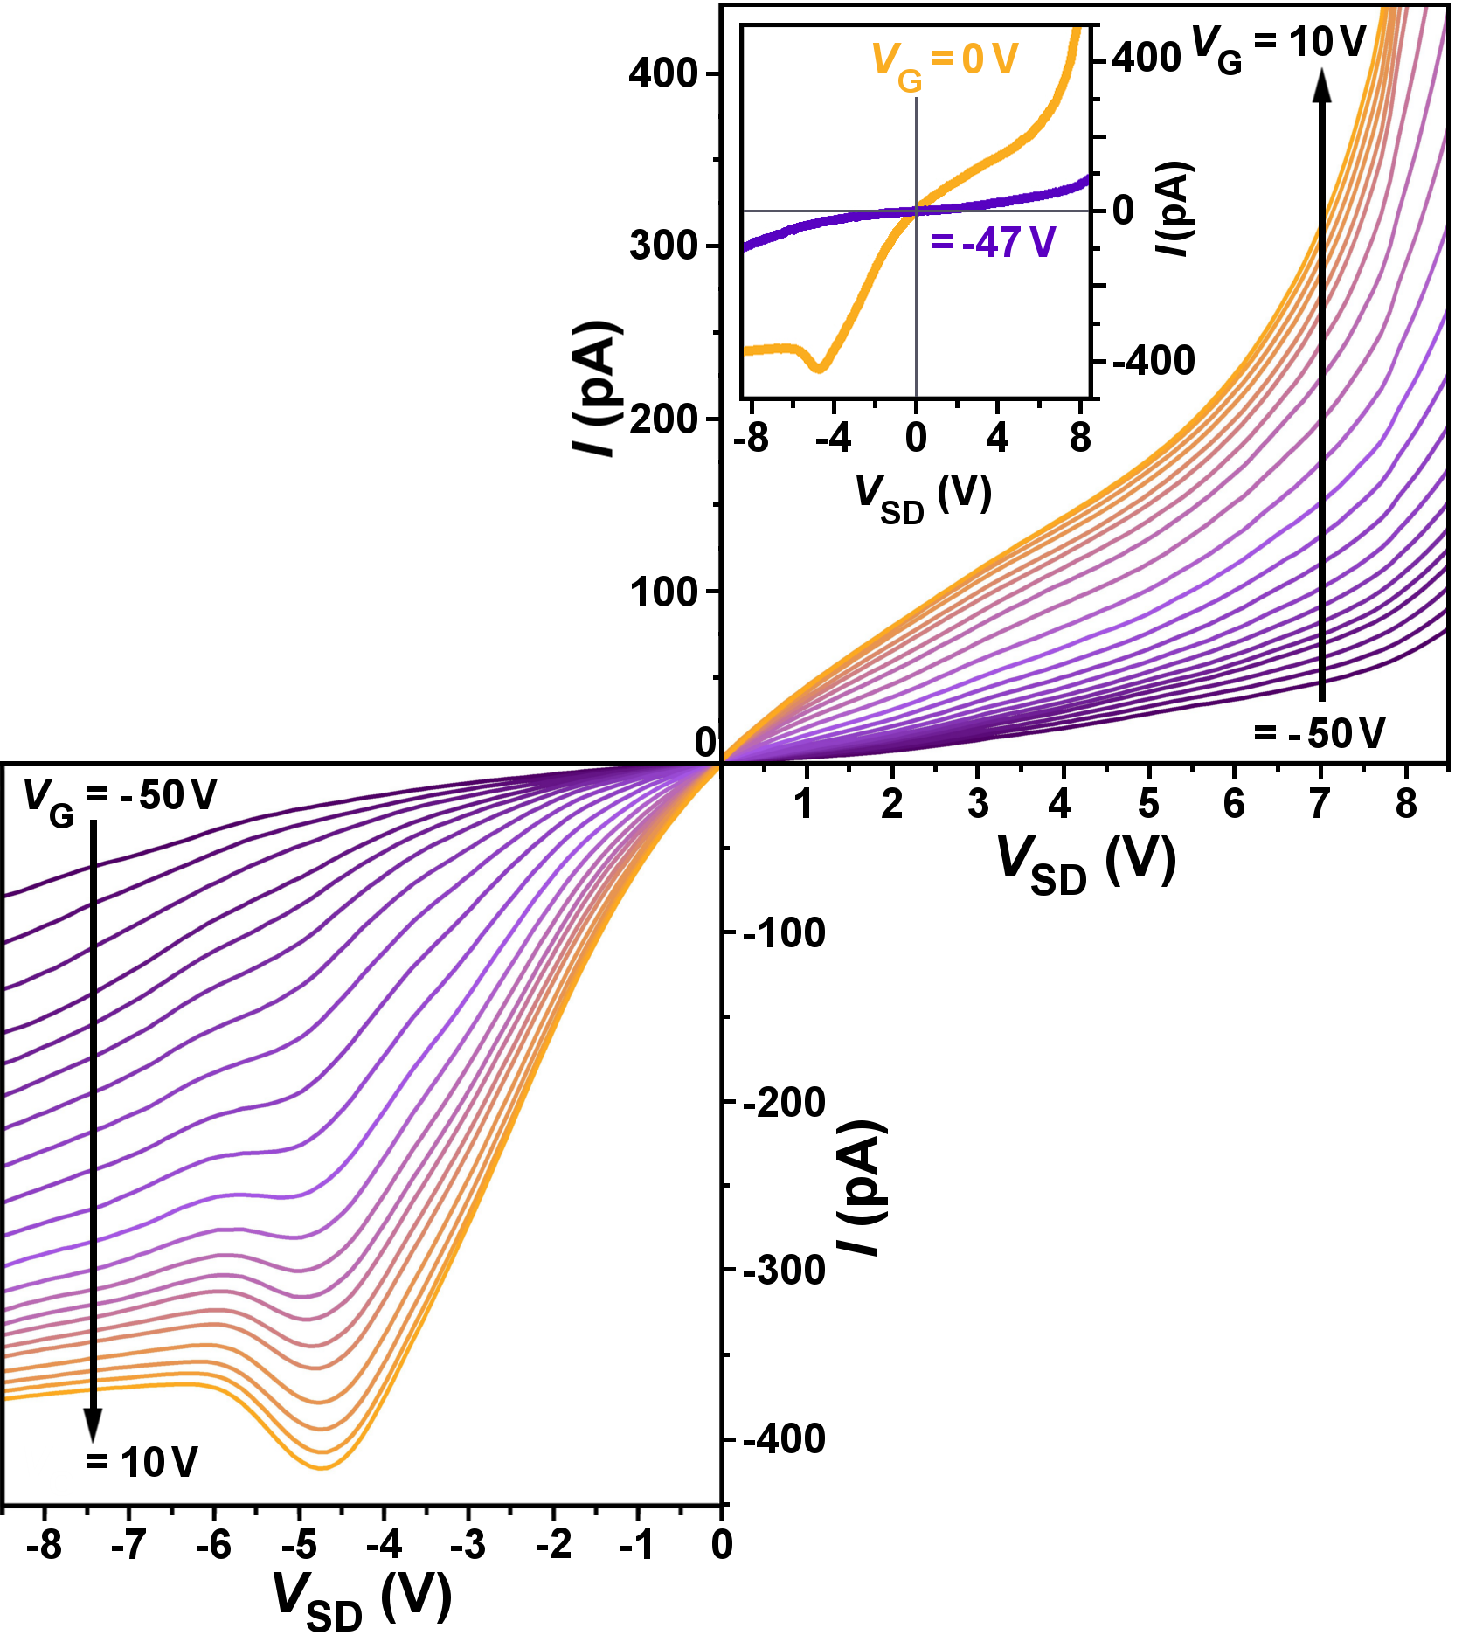
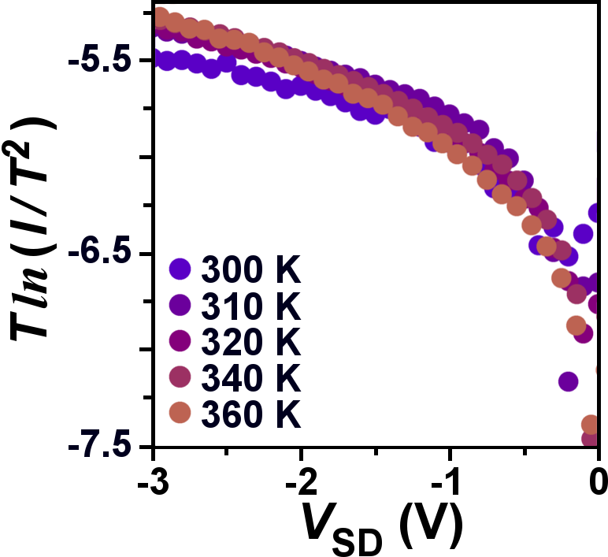
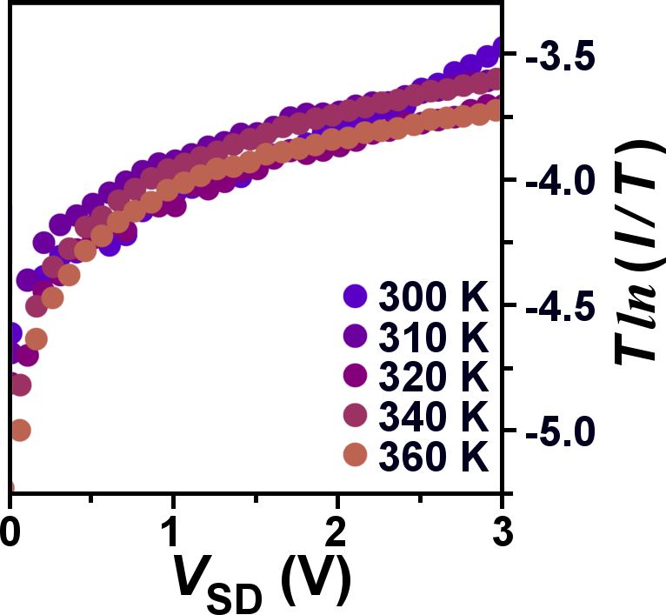
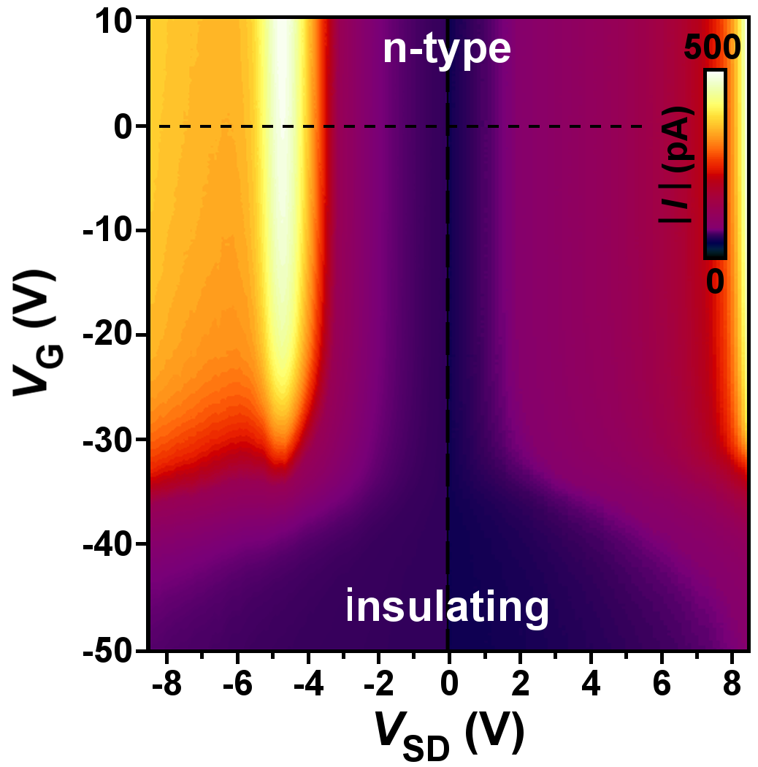
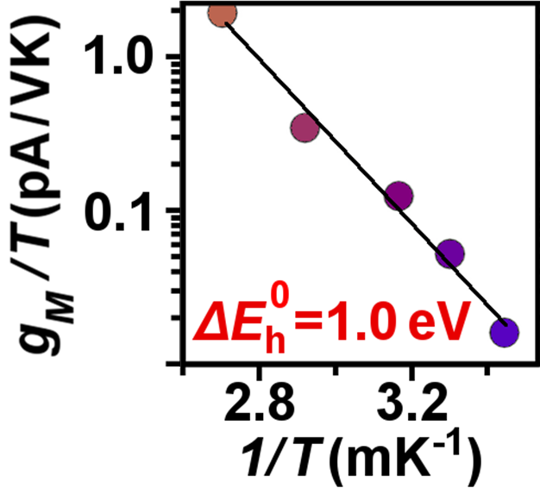
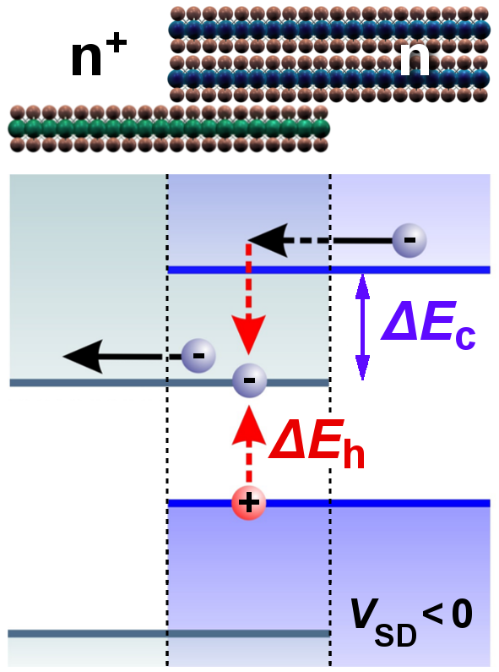
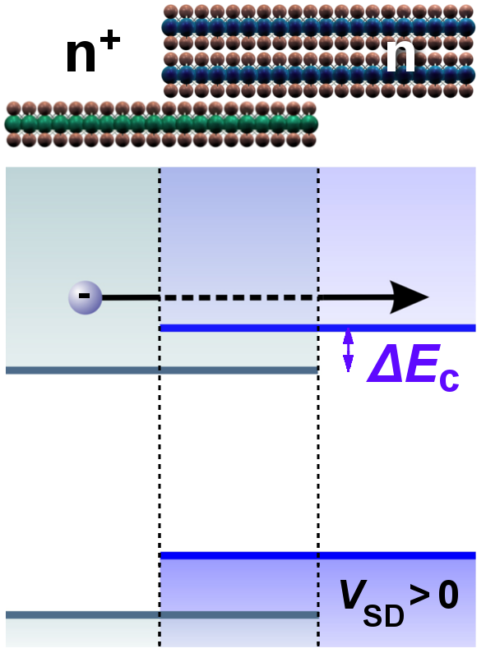
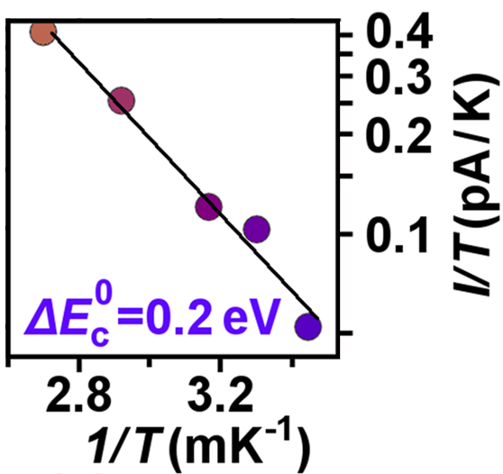
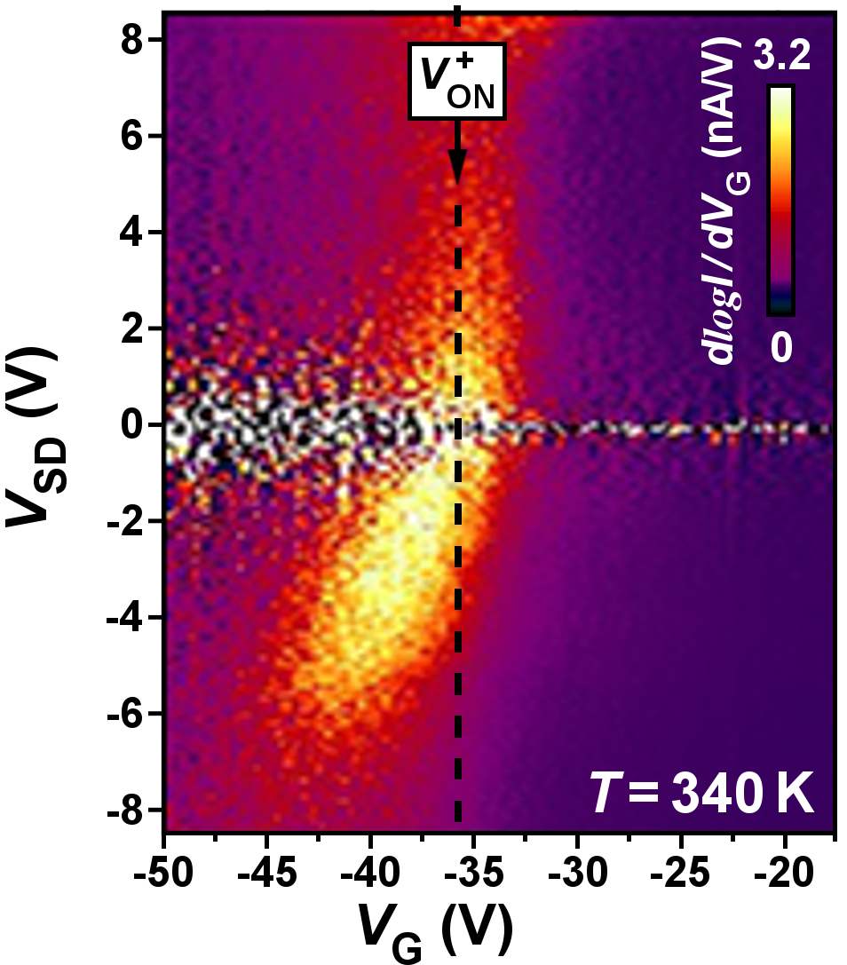
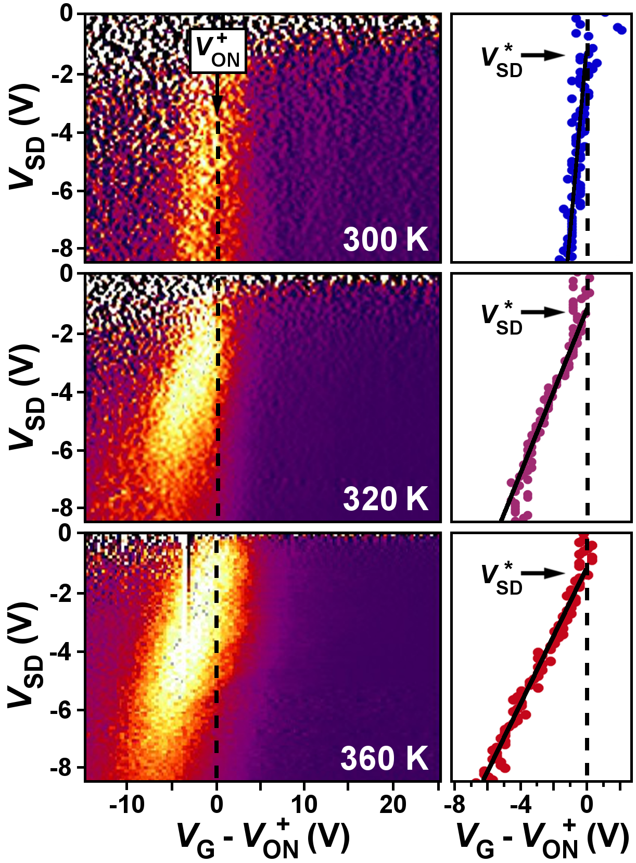
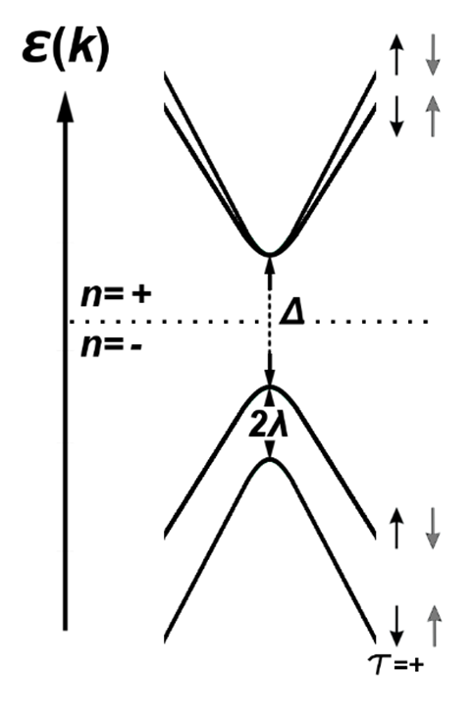
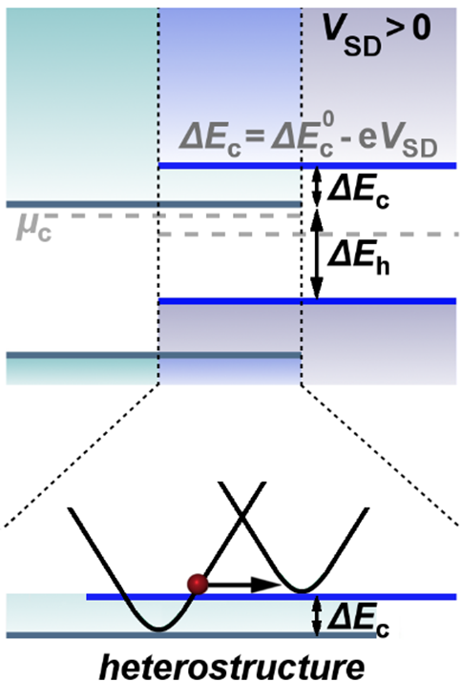
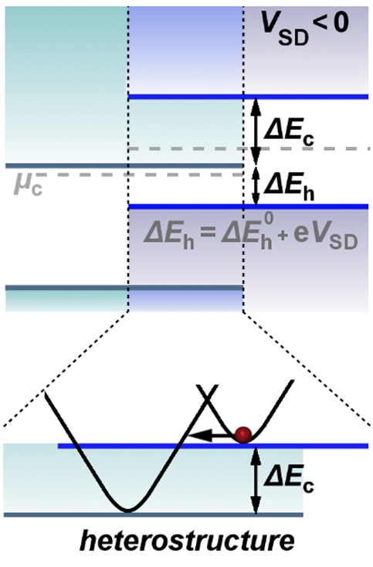
Interlayer impact excitation by hot electrons in an atomic layer semiconductor heterostructure
Fatemeh Barati^{1,2,4,†}, Max Grossnickle^{1,2,4,†}, Shanshan Su^{1,3,4},
Roger Lake^{1,3,4}, Vivek Aji¹, and Nathaniel M. Gabor^{1,2,4}
¹University of California at Riverside Department of Physics and Astronomy
²Quantum Materials Optoelectronics Laboratory
³Laboratory for Terascale and Terahertz Electronics (LATTE)
⁴SHINES Energy Frontier Research Center
MoSe₂- WSe₂ Device
Discussion
We fabricated a device from MoSe₂ and WSe₂ using exfoliated flakes. The device had source and drain contacts, as well as a back gate.
Transition metal dichalcogenides (TMDs) exhibit optoelectronic properties that vary strongly with sample thickness. By using them in Van der Waals heterostructures, we can custom-build novel devices perfectly tailored to the study of interlayer electron-hole pair (exciton) generation. Efficient generation of interlayer excitons could be used to make novel photodetectors, electroluminescent emitters, or excitonic integrated circuits.
In this work, we observed efficient multiplication of interlayer excitons by hot electron relaxation across the interface of a Van der Waals heterostructure. Electronic transport measurements showed large negative differential conductance, source-drain and gate voltage dependent interlayer current, and strong temperature dependence, all of which support hot electron relaxation as the interlayer exciton generation mechanism.
We used 2L-WSe₂ and ML-MoSe₂ in order to study electron transfer at the interface of this heterostructure.
Temperature dependence
The magnitude of the reverse bias interlayer current rapidly increases with temperature, with the maximum current at 360K being ten times as large as the maximum at 310K. Above 340K, NDC appears at high gate voltages. Asymmetry between forward and reverse bias at is also especially noticeable at 360K.
Photoluminescence of the overlap area shows significant suppression in the peaks when compared to the original flakes. The differences indicate that there is an additional electron relaxation mechanism.
Rescaling the reverse bias current as Tln(I/T²), collapses data at all temperatures to a single temperature-independent characteristic. Rescaling the forward bias current as Tln(I/T) similarly accounts for the temperature dependence.
IV characteristics
Large negative differential conductance is present in reverse bias.
In forward bias, current increases monotonically with positive gate voltage. The inset highlights the striking asymmetry present when the device is turned on.
Past a critical gate voltage, the location of the NDC remains constant in V_{sd}.
Impact excitation model
Device turn-on
$$\text{e}\text{W}\text{+}\text{Ke}\text{ →}\text{eMo}\text{+}\text{(}\text{e}\text{Mo}\text{+}\text{hW}\text{)}$$
The turn-on point of the device is identified by the maximum in dlogI/dV_{G}.
In forward bias, the turn-on occurs at a constant Vg but tilts in reverse bias.
This behavior is almost completely absent at room temperature but becomes more pronounced with increasing temperature.
V_{SD}* labels the intercept of the linear fits of the maxima of dlogI/dVg and V⁺_{ON}.
At voltages above V_{SD}*, interlayer transport occurs as low-energy electrons from the WSe₂ conduction band transfer into the higher energy states of MoSe₂ and gain additional kinetic energy.

